Slide 1
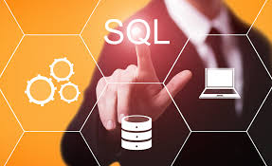
Presented by: Shubham Umesh Chavan

Slide 2
Agenda
Introduction To SQL
What is SQL?
Types of SQL Commands
Why SQL is Important
Simple SQL Examples
Conclusion

Slide 3
Introduction To SQL
SQL is a standard language for accessing and manipulating databases
SQL (Structured Query Language) is the standard language used to manage and manipulate data in databases.
It helps to create, read, insert ,update, and delete data efficiently.
SQL works with relational databases like MySQL, Oracle, and SQL Server.
It is widely used in applications ranging from banking to
e-commerce.

Slide 4
What is SQL?
SQL = Structured Query Language
Used to manage data in databases
Works behind the scenes in almost every software

Slide 5
Types of SQL Commands
DDL (Data Definition Language):
Create, modify, delete tables
DML (Data Manipulation Language):
Add, update, delete data
DQL (Data Query Language):
Fetch or view data
DCL (Data Control Language):
Manage permissions
TCL (Transaction Control Language):
Manage transactions (commit/rollback)

Slide 6
Why SQL is Important
Manages company data efficiently
Provides quick access for reports & decisions
Used by HR, finance, sales, and more
A key IT and business skill

Slide 7
Simple SQL Examples
SELECT name FROM employees; -- DQL: View data
INSERT INTO employees VALUES (...); -- DML: Add data
CREATE TABLE employees (...); -- DDL: Create table
COMMIT; -- TCL: Save transaction

Slide 8
Conclusion
SQL organizes and controls data
Widely used across industries
Learning SQL boosts your career
Helps both technical and business teams

Slide 9


